Slide 1


Shahid Hussain
15-Jan-2024

Slide 2

Outline
Executive Summary
Introduction
Methodology
Results
Conclusion
Appendix

Slide 3
Executive Summary
Summary of methodologies
Data Collection through API and Web Scrapping
Data Wrangling
EDA with SQL and Data Visualization
Building an interactive map with Folium
Building a Dashboard with Plotly dash
Predictive Analysis
Summary of all results
EDA results
Interactive analysis
Predictive analysis

Slide 4
Introduction
Project background and context
SpaceX advertises Falcon 9 rocket launches on its website, with a cost of 62 million dollars; other providers cost upward of 165 million dollars each, much of the savings is because SpaceX can reuse the first stage.
Problems you want to find answers
The project task is to predicting if the first stage of the SpaceX Falcon 9 rocket will land successfully

Slide 5

Section 1

Slide 6
Methodology
Executive Summary
Data collection methodology:
SpaceX Rest API and Web scrapping from Wikipedia
Perform data wrangling
Data was processed using one-hot encoding for catagorical feature and cleaning of null values and irrelevant columns
Perform exploratory data analysis (EDA) using visualization and SQL
Perform interactive visual analytics using Folium and Plotly Dash
Perform predictive analysis using classification models
LR, KNN SVM, DT models have been built and evaluated for the best classifier methodology

Slide 7
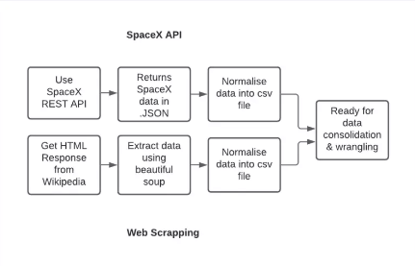
Data Collection
Describe how data sets were collected.
SpaceX launch data that is gathered from the SpaceX Rest API, gives information about the rocket used, payload delivered, launch specifications, landing specifications and landing outcome
Web scrapping was also done to gather the data
You need to present your data collection process use key phrases and flowcharts

Slide 8
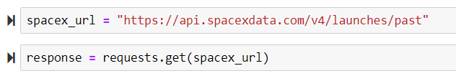
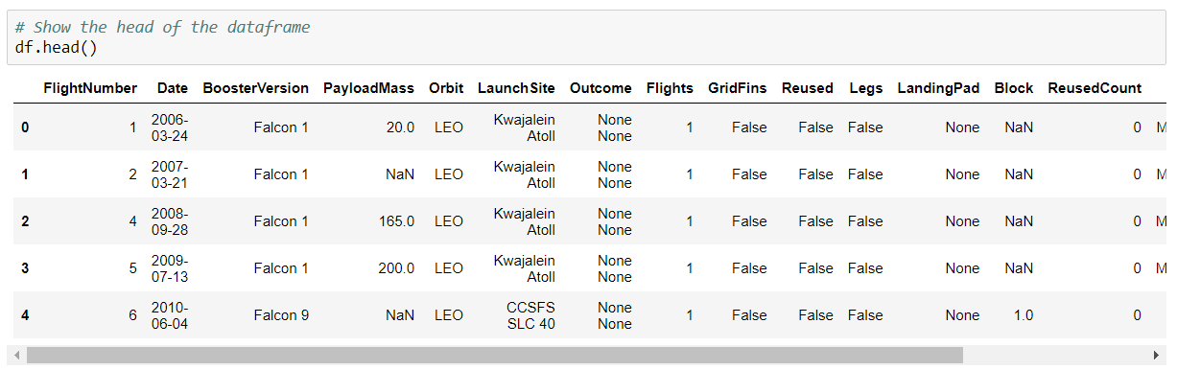
Data Collection – SpaceX API
Present your data collection with SpaceX REST calls using key phrases and flowcharts
GitHub URL of the completed SpaceX API calls notebook - https://github.com/uniqueshahid/data-science-capstone-project/blob/master/jupyter-labs-spacex-data-collection-api.ipynb

Slide 9
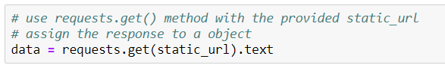
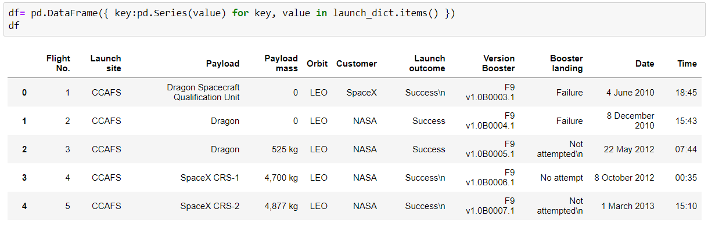
Data Collection - Scraping
Present your web scraping process using key phrases and flowcharts
GitHub URL of the completed web scraping notebook - https://github.com/uniqueshahid/data-science-capstone-project/blob/master/jupyter-labs-webscraping.ipynb

Slide 10
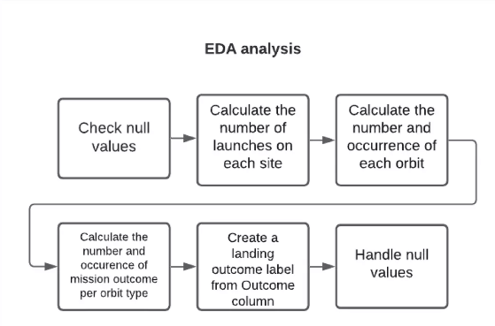
Data Wrangling
how data were processed
GitHub URL of your completed data wrangling related notebooks- https://github.com/uniqueshahid/data-science-capstone-project/blob/master/labs-jupyter-spacex-Data%20wrangling.ipynb

Slide 11
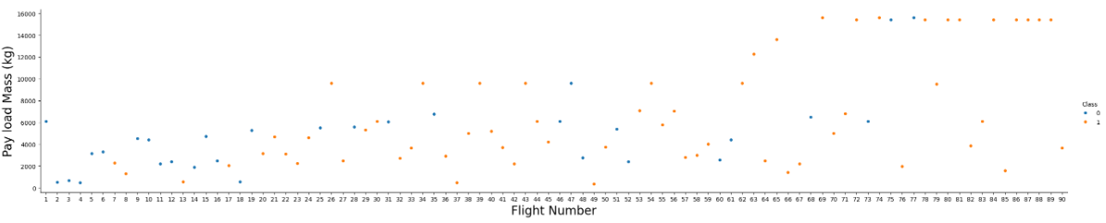
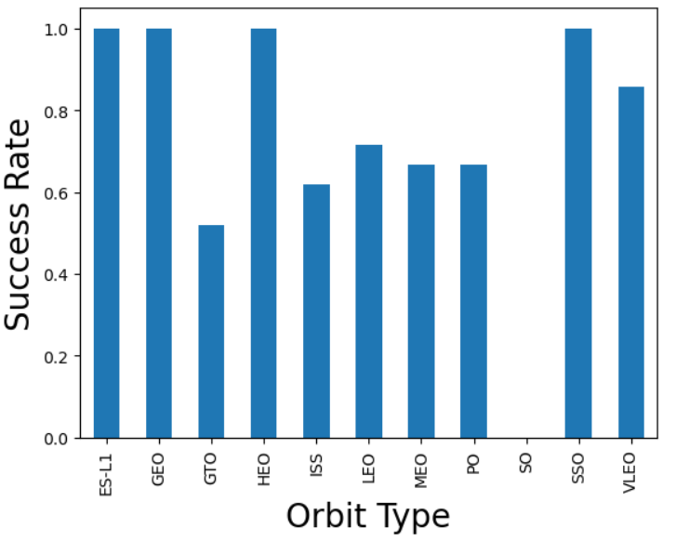
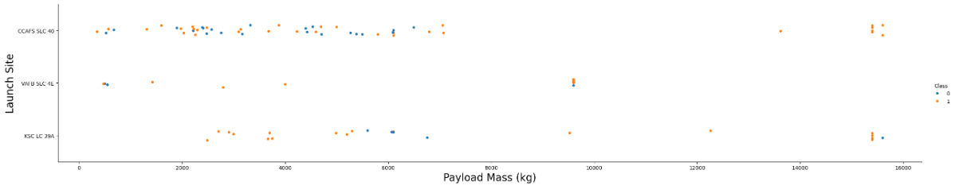
EDA with Data Visualization
Summarize what charts were plotted and why you used those charts
GitHub URL of your completed EDA with data visualization notebook - https://github.com/uniqueshahid/data-science-capstone-project/blob/master/jupyter-labs-eda-dataviz.ipynb.jupyterlite.ipynb

Slide 12
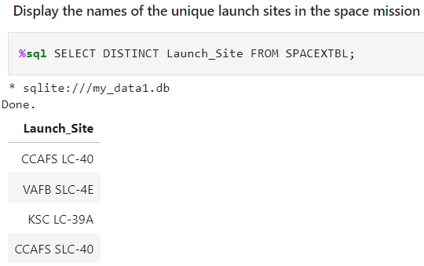
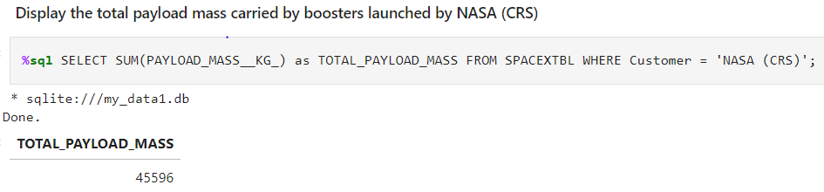
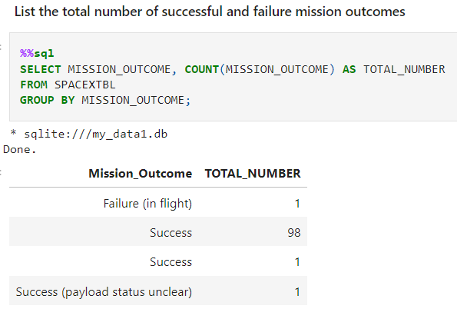
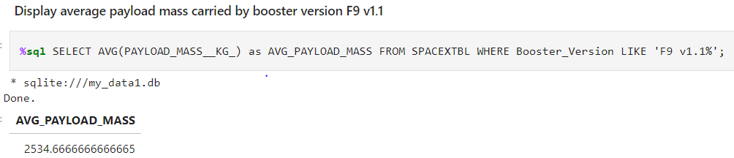
EDA with SQL
Using bullet point format, summarize the SQL queries you performed
GitHub URL of your completed EDA with SQL notebook - https://github.com/uniqueshahid/data-science-capstone-project/blob/master/jupyter-labs-eda-sql-coursera_sqllite.ipynb

Slide 13
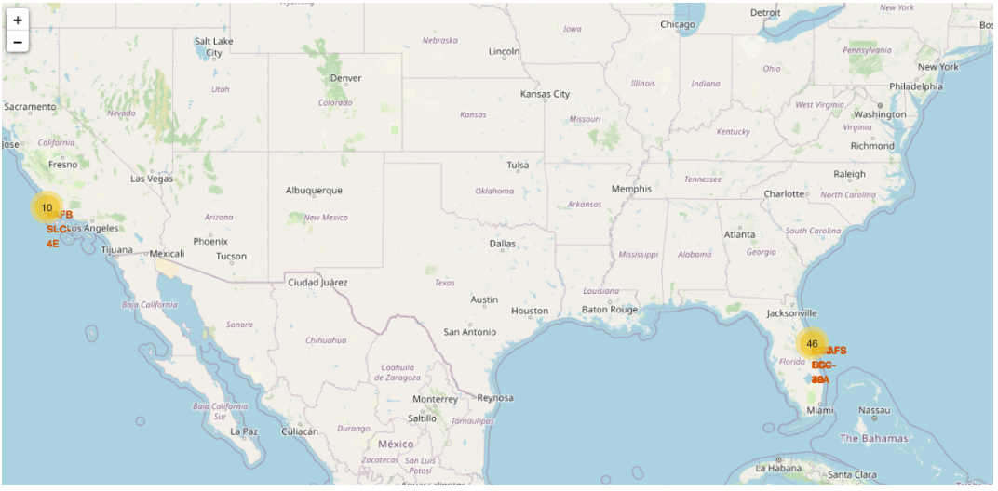
Build an Interactive Map with Folium
Map markers has been added to the map with aim to finding an optimal location for building a launch site
GitHub URL of your completed interactive map with Folium map - https://github.com/uniqueshahid/data-science-capstone-project/blob/master/lab_jupyter_launch_site_location.jupyterlite.ipynb

Slide 14
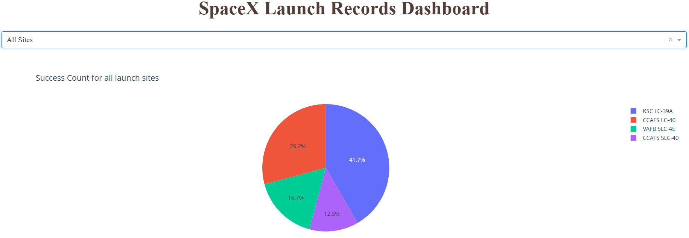
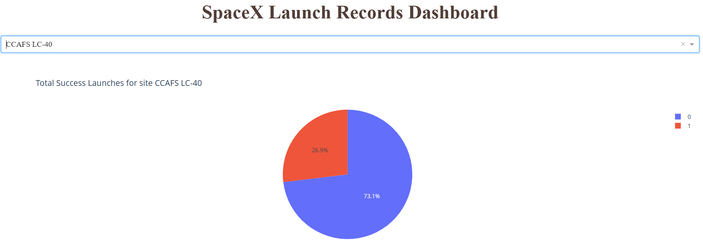
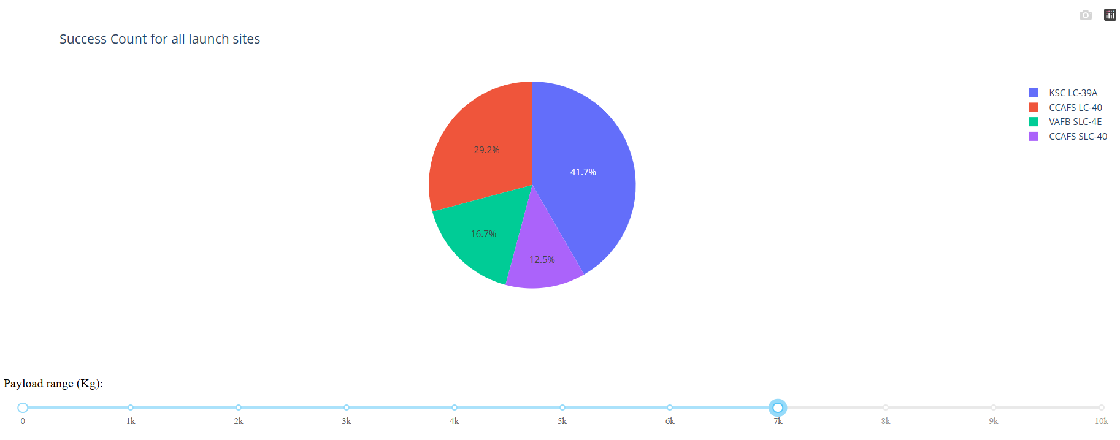
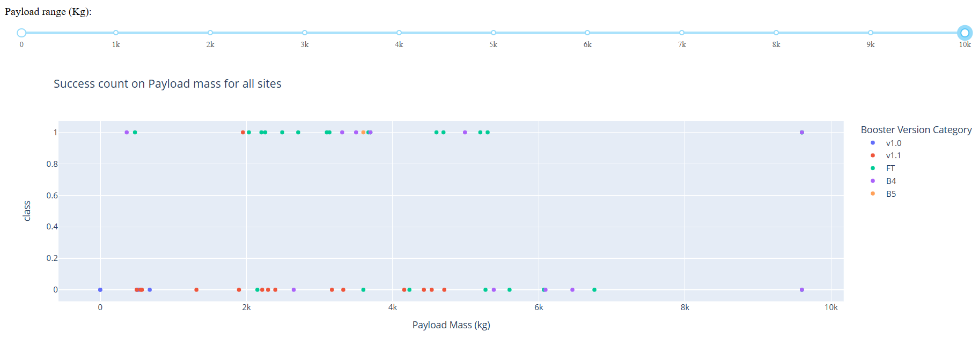
Build a Dashboard with Plotly Dash
GitHub URL of your completed Plotly Dash lab - https://github.com/uniqueshahid/data-science-capstone-project/blob/master/spacex_dash_app.py

Slide 15

Predictive Analysis (Classification)
The SVM, KNN and Logistic Regression model achieved the highest accuracy of 83.3%, while the SVM performs the best in terms of Area under Curve at 0.958
GitHub URL of your completed predictive analysis lab - https://github.com/uniqueshahid/data-science-capstone-project/blob/master/SpaceX_Machine_Learning_Prediction_Part_5.jupyterlite.ipynb

Slide 16
Results
The SVN, KNN and Logistic regression models are the best in terms of prediction accuracy for this dataset.
Low weighted payloads perform better than heavier payloads
The success rate for SpaceX launches is directly proportional time in years they will eventually perfect the launches
KSC LC 39A had the most successful launches from all the sites.
Orbit GEO, HEO, SSO, ES L1 has the best Success Rate

Slide 17

Section 2

Slide 18
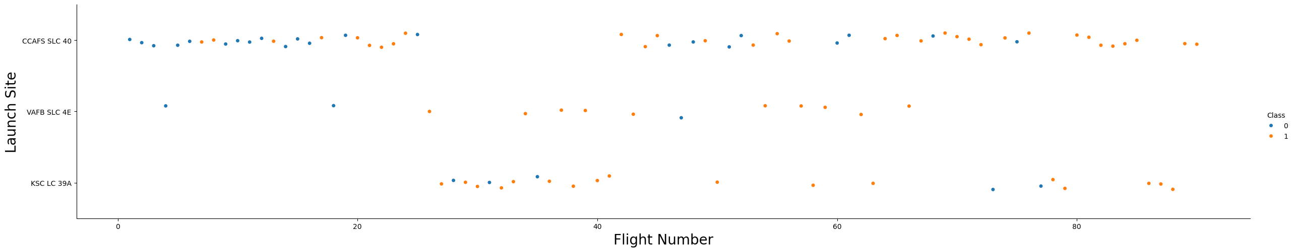
Flight Number vs. Launch Site
Launches from CCAFS SLC 40 are significantly higher than launches from other sites.

Slide 19
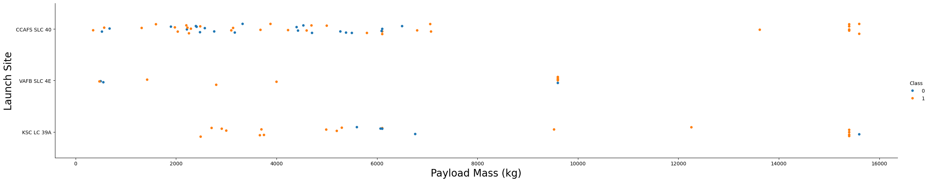
Payload vs. Launch Site
If we observe Payload Vs. Launch Site scatter point chart, we find that for the VAFB-SLC launchsite there are no rockets launched for heavy payload mass (greater than 10000)

Slide 20
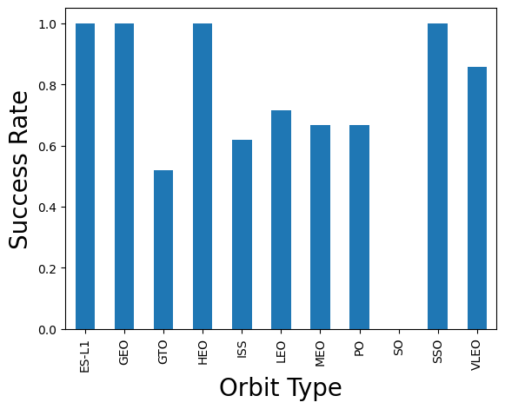
Success Rate vs. Orbit Type
The Orbit type of ES-L1, GEO, HEO, SSO are among the highest success rate

Slide 21
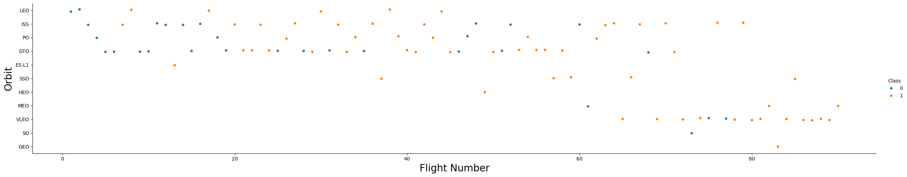
Flight Number vs. Orbit Type
From Flight number vs Orbit type scatter plot, a trend can be observed of shifting to VLEO launches in recent years

Slide 22
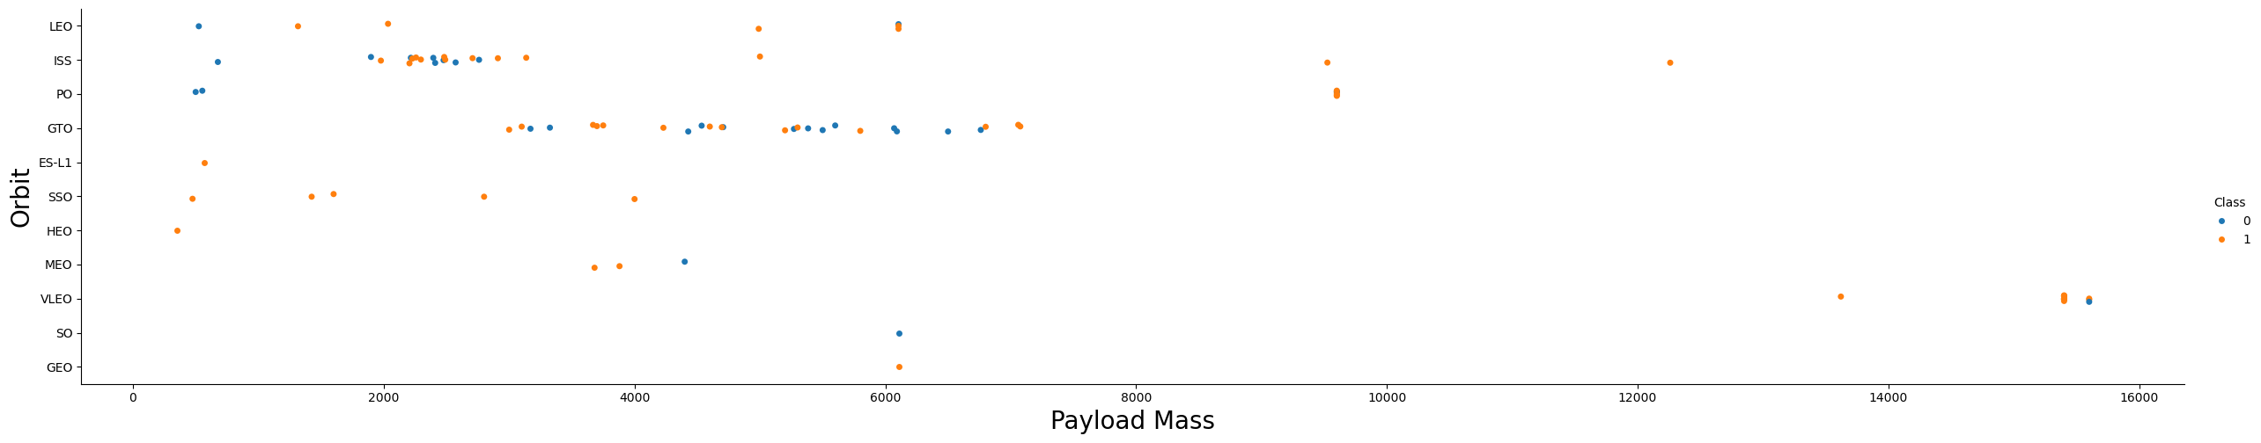
Payload vs. Orbit Type
There are strong correlation between ISS and Payload at the range around 2000, as well as between GTO and the range of 4000-8000.

Slide 23
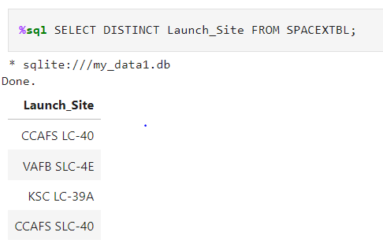
All Launch Site Names

Slide 24
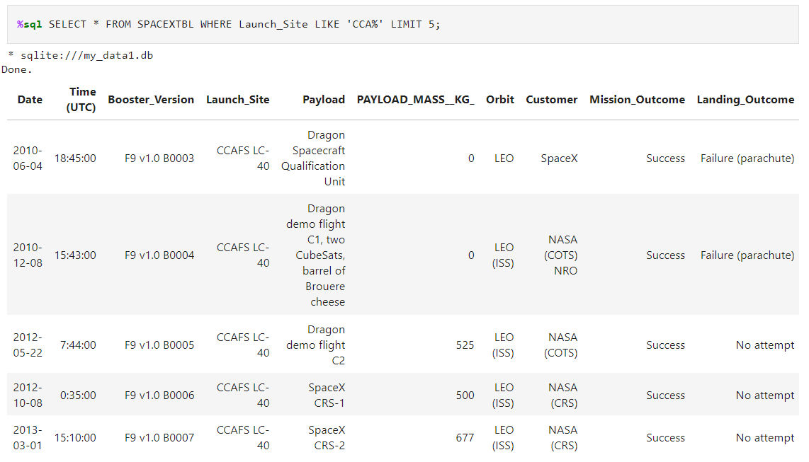
Launch Site Names Begin with 'CCA'

Slide 25
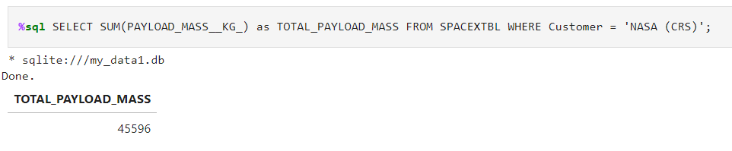
Total Payload Mass

Slide 26
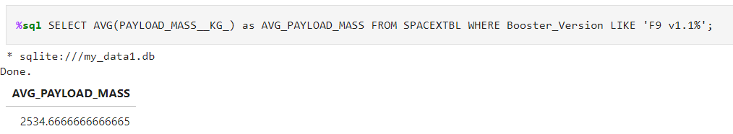
Average Payload Mass by F9 v1.1

Slide 27
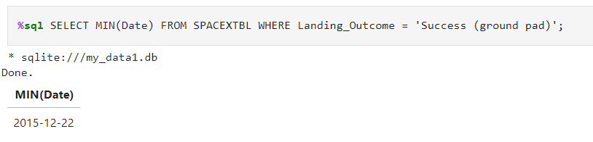
First Successful Ground Landing Date

Slide 28
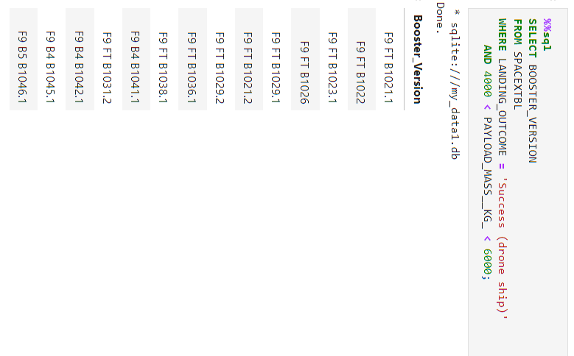
Successful Drone Ship Landing with Payload between 4000 and 6000

Slide 29
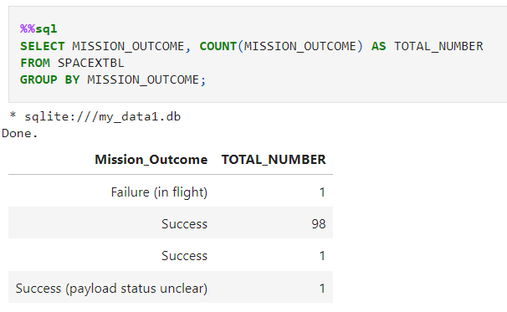
Total Number of Successful and Failure Mission Outcomes

Slide 30
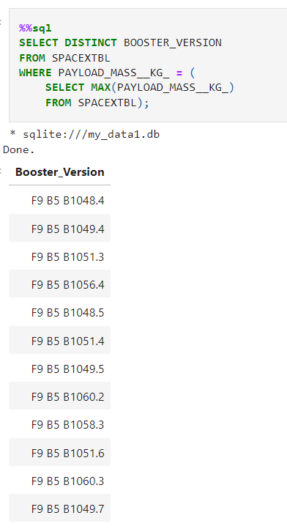
Boosters Carried Maximum Payload

Slide 31
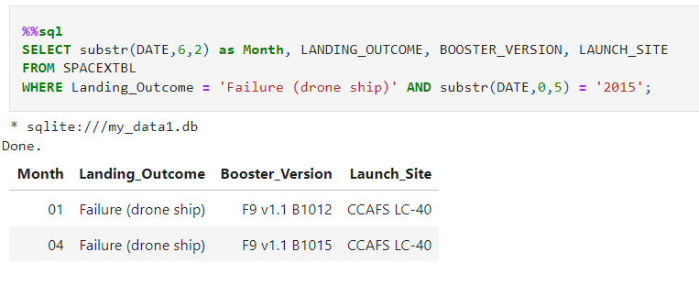
2015 Launch Records

Slide 32
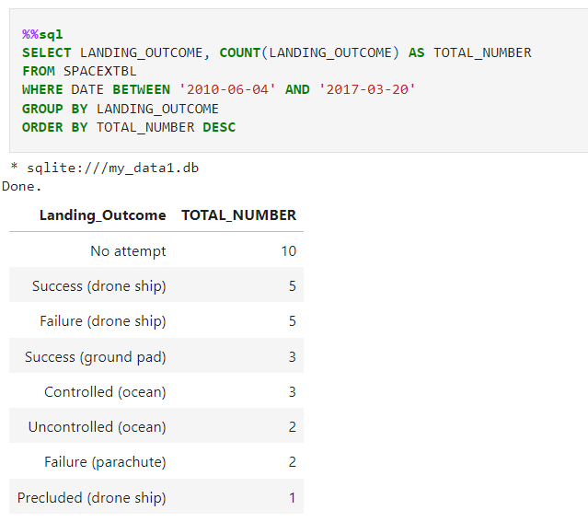
Rank Landing Outcomes Between 2010-06-04 and 2017-03-20

Slide 33

Section 3

Slide 34
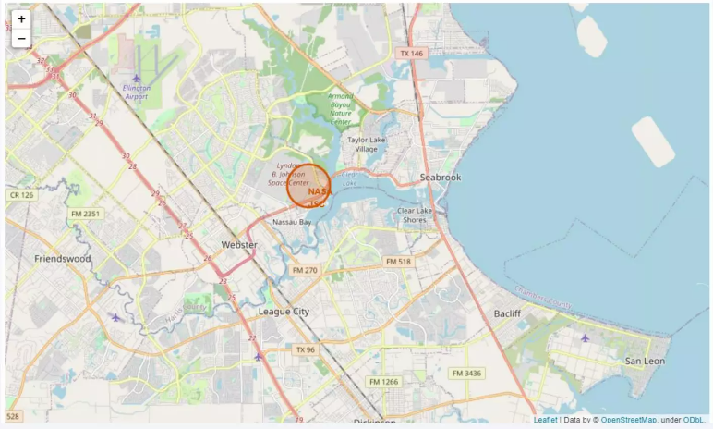
Launch Sites Marked on a Map

Slide 35
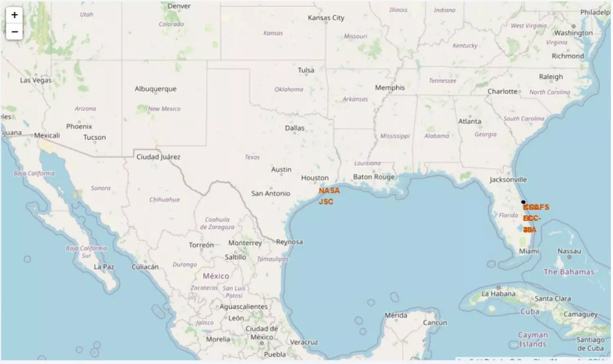
Success / Failed launches marked on Map

Slide 36
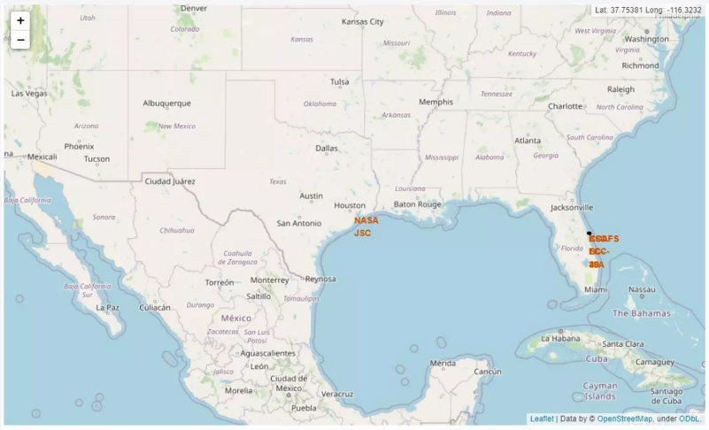
Distances between a launch site to its proximities

Slide 37

Section 4

Slide 38
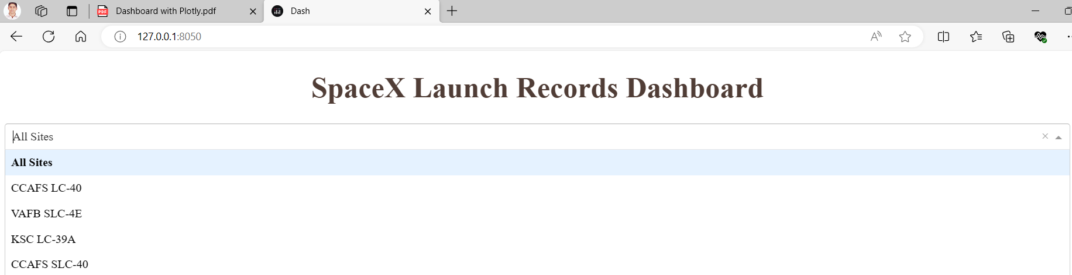
SpaceX Launch Records Dashboard

Slide 39
Total Success Launches for all sites

Slide 40
Payload vs Launch Outcome

Slide 41

Section 5

Slide 42
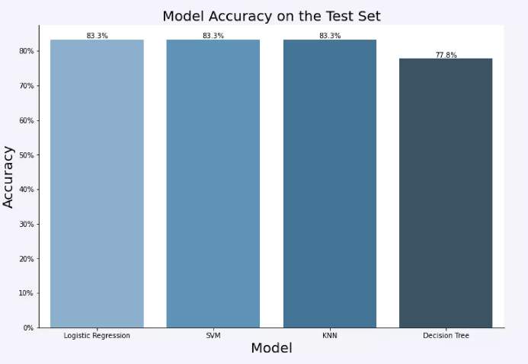
Classification Accuracy

Slide 43
Confusion Matrix

Slide 44
Conclusions
The SVM, KNN, and Logistic Regression models are the best in terms of prediction accuracy for this dataset.
Low weighted payloads perform better than the heavier payloads.
The success rates for SpaceX launches is directly proportional time in years they will eventually perfect the launches.
KSC LC 39A had the most successful launches from all the sites.
Orbit GEO,HEO,SSO,ES L1 has the best Success Rate

Slide 45


